Slide 1
Machine Learning Fundamentals: Date-A-Scientist
Matt Lollini, 11/15/2018

Slide 2
Table-of-Contents
Description | Slide Number
Data Exploration – User Religion | 3
Data Exploration – User Age | 4
Questions (Q1, Q2) | 5
Q1 - Data Maps | 6
Q2 - Word Lists | 7
Q1 – Classification Approach | 8
Q1 – Accuracy | 9
Q2 – Regression Approach | 10
Q2 - Accuracy | 11
Final Thoughts | 12

Slide 3
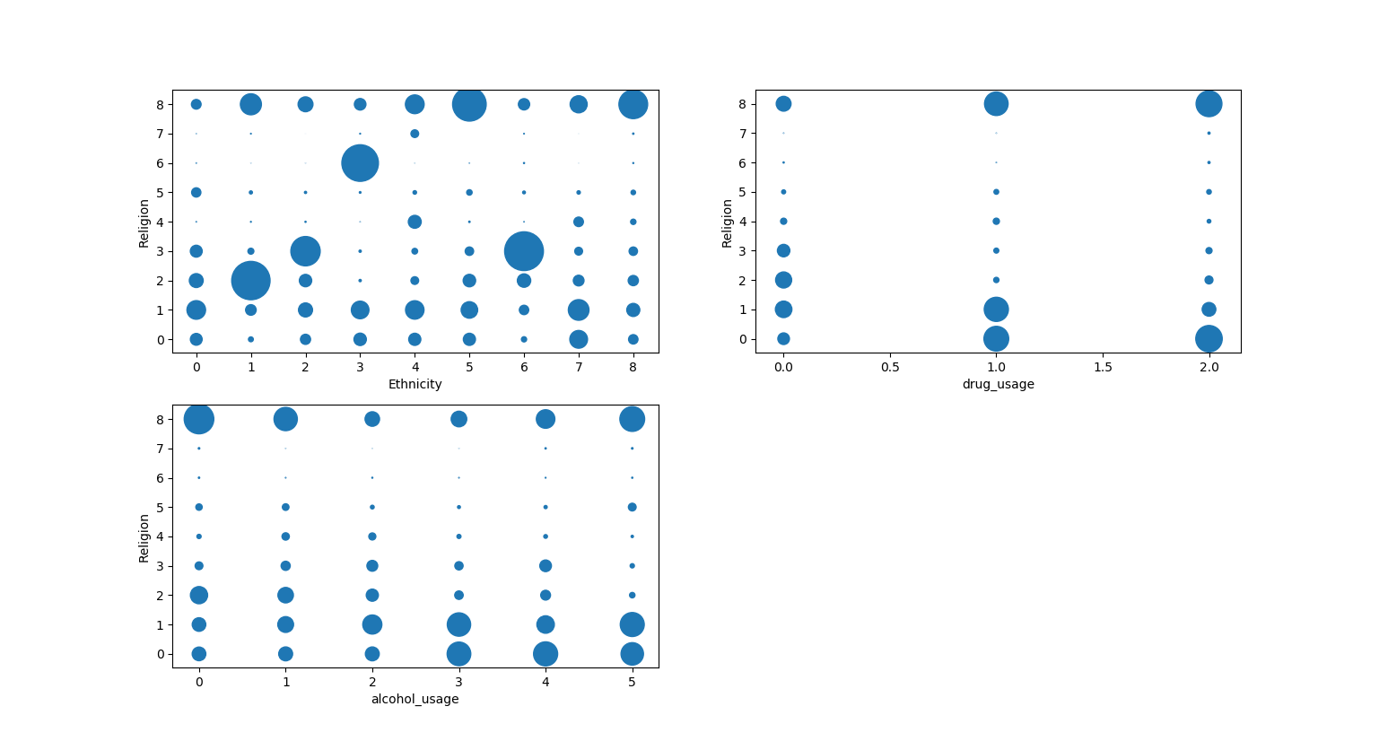
Data Exploration – Religion vs. Ethnicity / Drugs / Alcohol
These bubble charts shows the occurrence of a given religion compared to the users; ethnicity, drug usage, and alcohol usage. Each bubble grows in size as the frequency of occurrence increases (IE. Ethnicity 1 is most commonly seen in Religion 2.)
The growth of each bubble is exponential in order to better visualize the data.

Slide 4
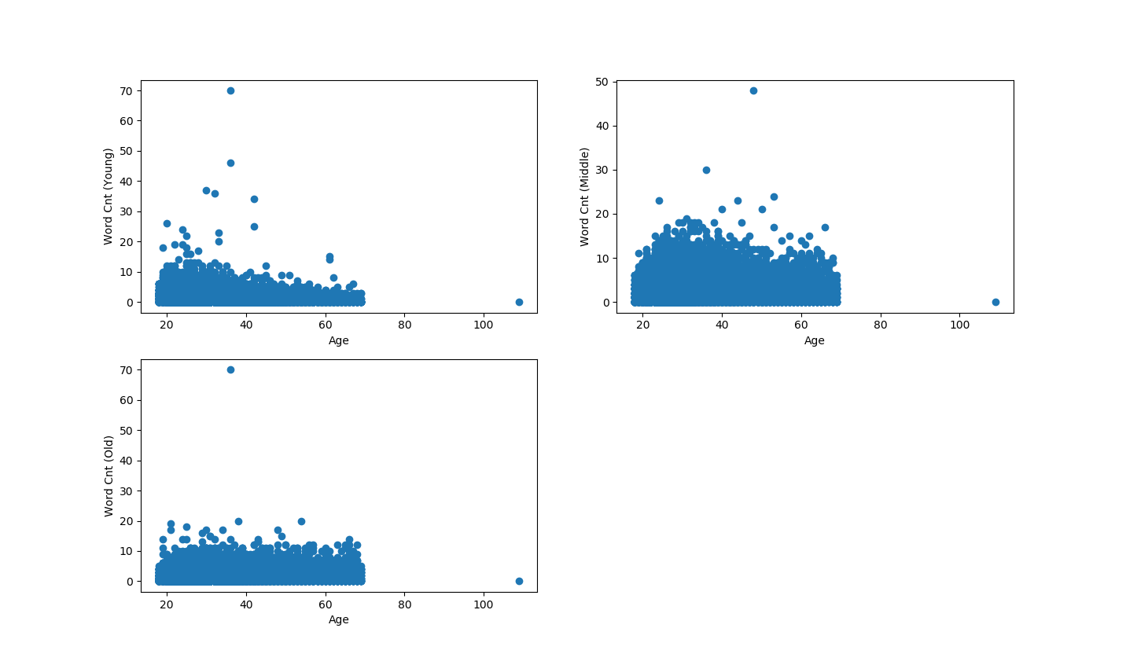
Data Exploration – Ages vs Word Counts
In this data exploration we are comparing age to the number of times specific word lists were used in each essay.
3 word lists were created to compare age against using words commonly used by different age groups.

Slide 5
Questions
Question 1:
Can we predict a users Religion based on ethnicity, drug usage, and alcohol usage?
Question 2:
Can we predict a users age, based on how often certain words are used in their essays?
(IE. If a user mentions YouTube multiple times in his essays is he more likely to be of a younger age.)

Slide 6
Data Maps
4 Different Maps were used to augment the data to apply various machine learning techniques. First various columns were analyzed using .value_counts() to determine how the map needs to be set. Then within each column specific text was selected and the map was applied to the results.
*Note: Assumptions needed to be made for ethnicity as many users had multiple ethnicities. To account for this only the first listed ethnicity was selected under the assumption this is the ethnicity the user most identifies with.
religion_mapping = {'atheism': 0, 'agnosticism': 1, 'christianity': 2, 'catholicism': 3, 'judaism': 4, 'buddhism': 5, 'hinduism': 6, 'islam': 7, 'other': 8} ethnicity_mapping = {'asian': 0, 'black': 1, 'hispanic ': 2, 'indian': 3, 'middle eastern': 4, 'native american': 5, 'pacific islander': 6, 'white': 7, 'other': 8} drug_mapping = {"never": 0, "sometimes": 1, "often": 2} alcohol_mapping = {'not at all': 0, 'rarely': 1, 'socially': 2, 'often': 3, 'very often': 4, 'desperately': 5}

Slide 7
Word Lists
3 Different word lists were created in attempt to identify different age groups. All essays were then analyzed to determine how often the words in each of these lists were used for each user.
list_young = ['party', 'parting', 'school', 'beach', 'shit', 'fuck', 'internet', 'weekend', 'workout', 'youtube', 'exams', 'hungover', 'lol']
list_middle = ['bills', 'work', 'coworkers', 'drinks', 'friends', 'office', 'company', 'apartment', 'money', 'relax', 'wedding', 'manager', 'boss']
list_old = ['yard', 'children', 'child', 'family', 'blessed', 'loving', 'country', 'prayers', 'thankful', 'home', 'house', 'employee', 'employees']

Slide 8
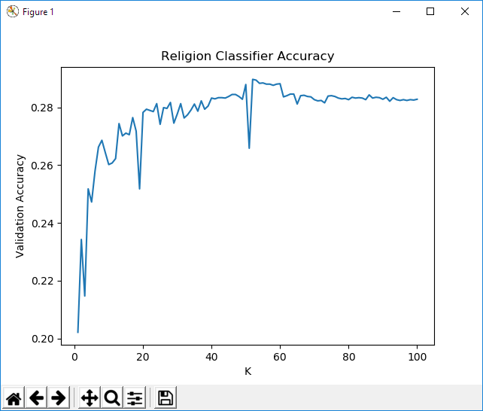
Question 1: Classification Approach
Can we predict a users Religion based on the users ethnicity, drug usage, and alcohol usage?
To answer this question a new data set that included the users religion, ethnicity, drug usage, and alcohol usage mappings.
This data was then run through both the KNN and Naïve Bayes classification approaches. For KNN an additional for loop was needed to determine the best number of neighbors to use. (It was found that a neighbor of ~21 resulted in the best accuracy while still keeping n relatively small.

Slide 9
Question 1: Accuracy
Using the KNN Classifier an accuracy of ~28% was able to be achieved.
Using The Naïve Bayes Classifier an accuracy of ~22% was able to be achieved.
In both cases the classifier has a higher accuracy than guessing (1/9 or 11% accuracy). Although the classifier is better than a guess it is not very accurate a predicting the users religion.

Slide 10
Question 2: Regression Approach
Can we predict a users age, based on how often certain words are used in their essays?
To answer this question a new data set that included the users age, and 3 columns each with the total number of occurrences of all words in the given word lists.
This data was then run through a linear regression model to predict the users age based on the counts from each word list.

Slide 11
Question 2: Accuracy
Using a Linear Regression model an accuracy of only 4.4% was achieved.
These results show that usage of the word lists, in each essay is a poor indicator of age.

Slide 12
Final Thoughts
For question 1 an accuracy of 28% was able to be achieved in predicting a users religious beliefs.
For further analysis I would attempt to drop “other and atheism” from the list as they are going to be the most varied and I believe skewed the results. If we would keep these religious beliefs in the mix I would add additional categories such as age, to assist the model in its predictions.
For question 2 an accuracy of only 4% was achieved in predicting the users age based on the types of words used in their essays.
The poor results are not too surprising as the word_list were put together with very little research. A better approach would have been to analyze the different words actually used in essays, as well as group the ages. As predicting an exact age is going to be less accurate then predicting an age group based on the word usages.

